Slide 1
CS5551 Advanced Software Engineering Design Patterns: Factory Method
Team 3

Slide 2
FACTORY METHOD
It is a creational pattern that uses factory methods to deal with the problem of creating objects without having to specify the exact class of the object that will be created.
This is done by creating objects by calling a factory method—either specified in an interface and implemented by child classes, or implemented in a base class and optionally overridden by derived classes—rather than by calling a constructor.

Slide 3
Features
Factory Method is to creating objects as Template Method is to implementing an algorithm.
Factory Method makes a design more customizable and only a little more complicated.
Factory Method is similar to Abstract Factory but without the emphasis on families.
Factory Methods are routinely specified by an architectural framework, and then implemented by the user of the framework.

Slide 4
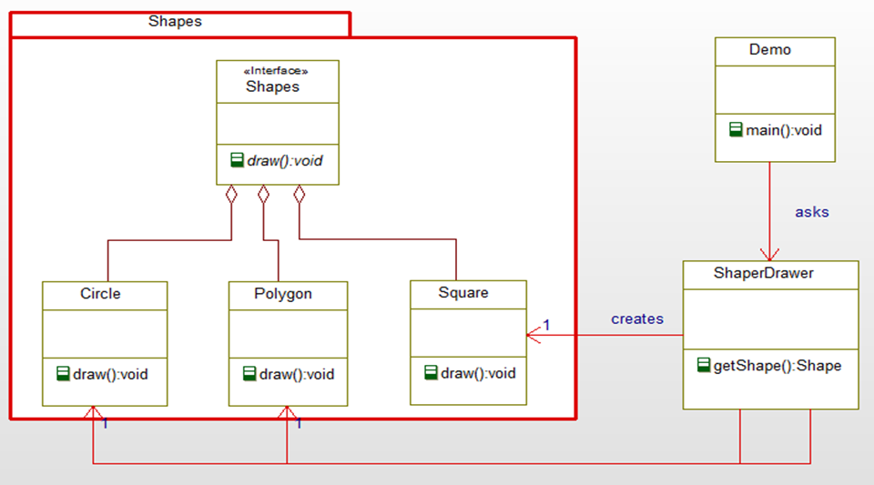
Class Diagram

Slide 5
Implementation
Shape.java
Circle.java
Square.java
Polygon.java
ShapeDrawer.java
Demo.java
Output

Slide 6
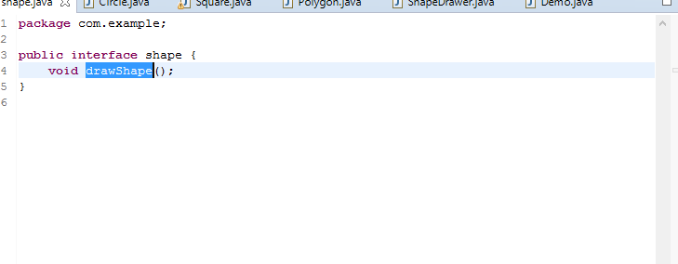
Shape.java

Slide 7
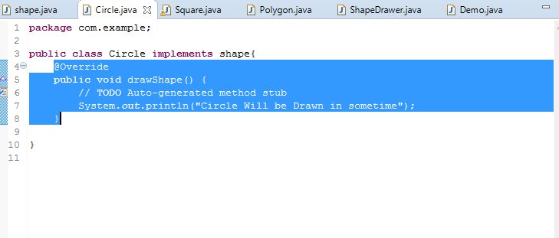
Circle.java

Slide 8
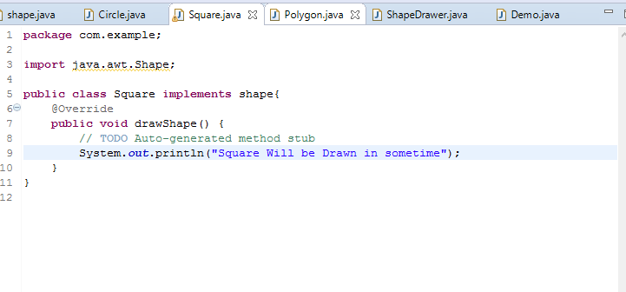
Square.java

Slide 9
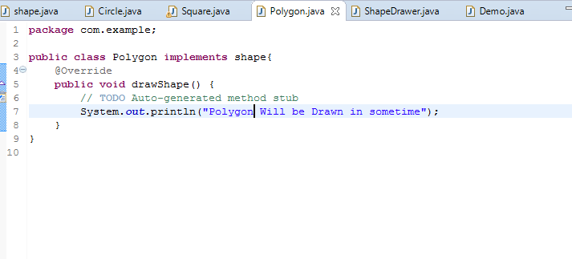
Polygon.java

Slide 10
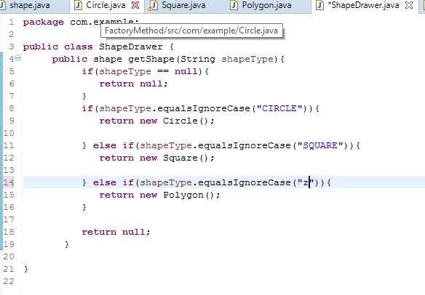
ShapeDrawer.java

Slide 11
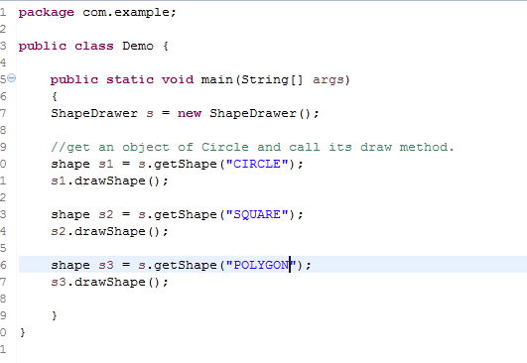
Demo.java

Slide 12
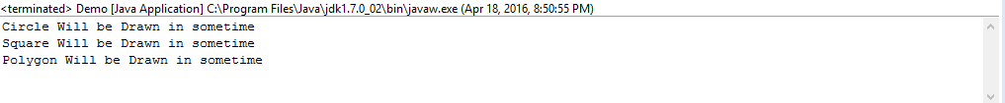
Output

Slide 13
Limitations:
The first limitation is that refactoring an existing class to use factories breaks existing clients.
The second limitation is that, since the pattern relies on using a private constructor, the class cannot be extended. Any subclass must invoke the inherited constructor, but this cannot be done if that constructor is private.
The third limitation is that, if the class were to be extended (e.g., by making the constructor protected—this is risky but feasible), the subclass must provide its own re-implementation of all factory methods with exactly the same signatures.
All three problems could be alleviated by altering the underlying programming language to make factories first-class class members

Slide 14
References:
https://en.wikipedia.org/wiki/Factory_method_pattern
http://www.oodesign.com/factory-method-pattern.html
https://sourcemaking.com/design_patterns/factory_method
http://www.tutorialspoint.com/design_pattern/factory_pattern.htm

Slide 15
THANK YOU !!

